Slide 1

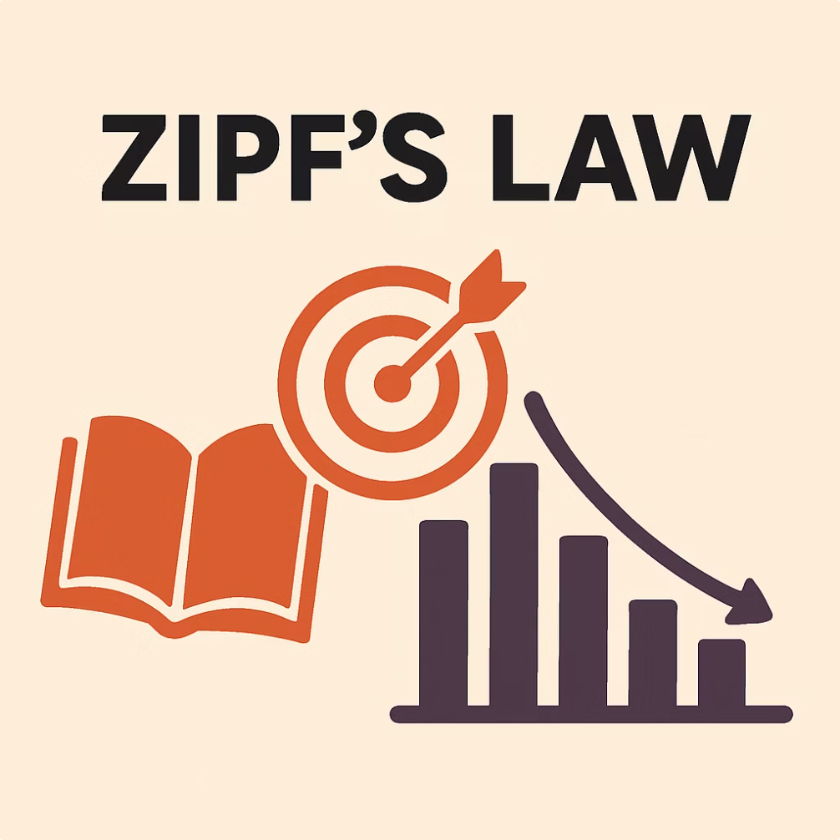
Zipf's Law in Drake's Lyrics
Exploring Patterns in Word Frequencies

Slide 2
Introduction to Zipf's Law
Definition
Formula
Word frequency inversely proportional to its rank in text.
f(n) ≈ 1/(n^s); where n is rank, s is about 1.
Significance
Examples
Appears in many languages and diverse datasets naturally.
Commonly seen in large collections of text like books.

Slide 3

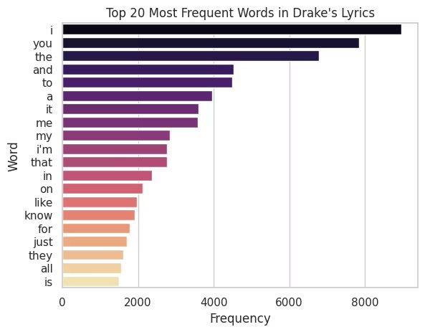
Project Methodology
1
Data Source
Used provided Drake.csv file.
2
Data Cleaning
Removed punctuation, stop words, and lemmatized words.
3
Frequency Analysis
Computed word frequencies and ranked them in order.
4
Tools Used
Python libraries: Numpy, Pandas, Matplotlib, Seaborn.

Slide 4
Data Visualization and Analysis
Ranked Frequency Plot
Log-Log Plot
Regression Analysis
Deviation
Linear pattern confirms Zipfian distribution.
Outliers reveal unique linguistic or album-specific effects.
Shows power law distribution in word usage.
R-squared of 0.87 indicates strong model fit.

Slide 5
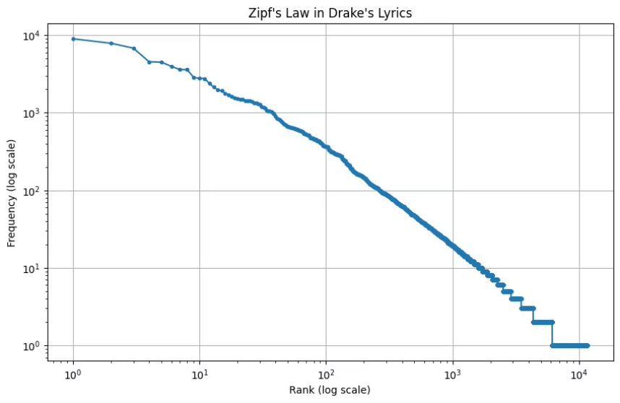
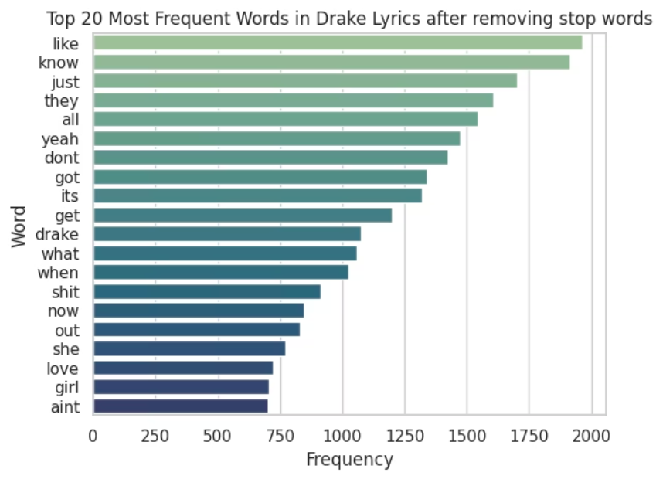
Key Findings & Insights
Zipf's Law Confirmed
Drake's lyrics closely follow expected word rank patterns.
Common Themes
Frequent words relate to like, know, and fame topics.
Outlier Words
Unique terms tied to specific albums or time periods.
Word Ratios
Top 10 words hold 20% of corpus; top 100 hold 40%.

Slide 6
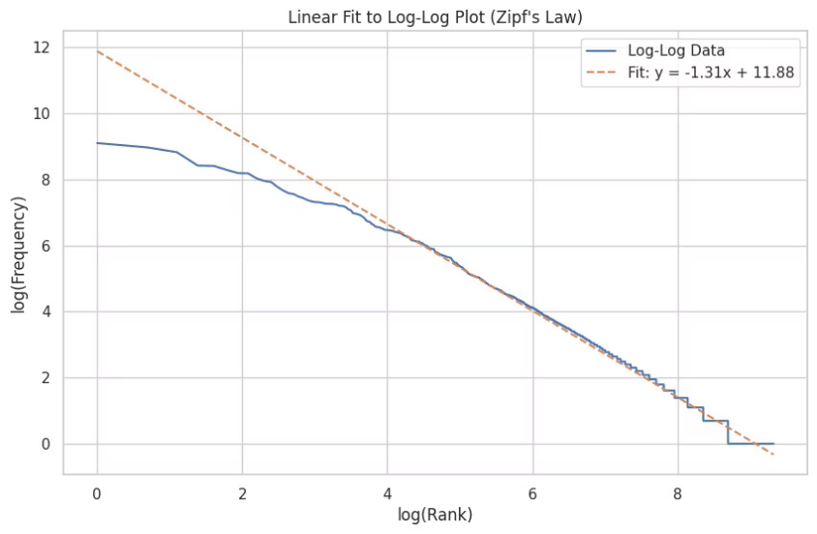

Creative Applications of Zipf's Law
Authorship Attribution
Use word patterns to identify lyric authorship.
Genre Classification
Distinguish musical styles by lexical frequency features.
Predictive Text Models
Enhance language models by understanding word usage.
Example Comparison
Contrast Drake’s word use with Kendrick Lamar’s style.

Slide 7





Conclusion
Zipf's Law Confirmed:
Log-Log Trend:
Stop Words Removed:
Drake’s lyrics follow Zipf’s Law – few words occur very frequently.
The frequency vs. rank plot is nearly linear on a log-log scale.
Filtering stop words revealed meaningful, content-rich vocabulary.
Zipf Exponent ≈ -1:
Language Pattern :
The slope of the regression line closely matches Zipf’s prediction.
Even creative text like rap lyrics follows natural language laws.

Slide 8
Team Contributions
Shivansh Bhargava
Devansh Saini
Om Gupta
Kirti Gautam
Led data collection, cleaning, and initial word frequency analysis.
Handled visualization design and statistical regression tests.
Interpreted findings and explored creative uses of Zipf's Law.
Managed presentation design and project coordination efforts.

Slide 9
THANK YOU

